Slide 1

Supervised By: Prof.Laila AbdElhamid

Slide 2

Our Team

Slide 3






Dins Hosny
Esraa Mahmoud
Hagar Ahmed
Haidy Ashraf
Mahammad Tarek
Mazen Fahmi

Slide 4
01
03
05
07
09
Introduction
ChainCare
Features
Implementation
Market Analysis
Table of contents
Problem Statement
Objectives
Technologies
Demo
Future Works
02
04
06
08
10

Slide 5

Introduction

Slide 6

Information Saves Lives!
Age: 15
Gender: male
Allergies: None
Blood Type: AB+
More information about the patient helps doctors with more accurate medical decisions
How can we use this information to achieve the major use?

Slide 7

Problem Statement

Slide 8



Hospitals hold multiple, fragmented, and increasing patients’ health records
Data Unavailability!
Critical Situations

Slide 9

What is ChainCare?

Slide 10
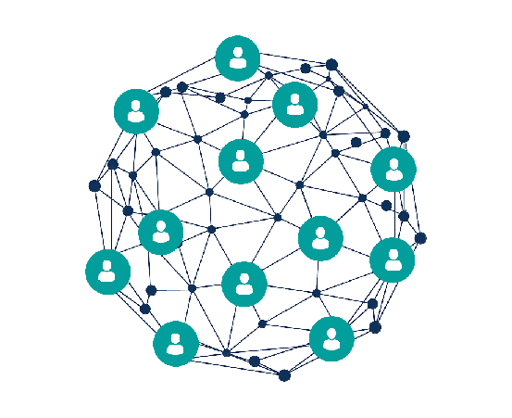

ChainCare is a health information system that uses smart contracts to handling the medical procedures and stores the medical history in Block Chains.

Slide 11

ChainCare Objectives

Slide 12



Increase quality of communication between the patients and the medical staff
Provides accurate, up-to-date, and complete information about patient, and proffisional history for doctors
Reduce Medical Errors, diagnose potient, and provide safer care

Slide 13



Securely sharing electronic information with patient and other medical staff
Can be used to generate analytical reports and statics
Reduce costs by decreasing paper works, reduce the unneeded duplication of testing and improved health

Slide 14

ChainCare Features

Slide 15






System Features
Critical information is stored significantly in an End-to-End encrypted records
Provides user’s privacy by managing permissions guarantee preventing unauthorized access
Provides high availability of information as it is stored in Block Chain which is can be accessed remotely
Information is organized in a time-variant and non-volatile way
Enables diseases prediction according to user entered symptoms

Slide 16



Patients Features
Allows monitoring accounts for special cases
Allows sharing records with medical staff or other users

Slide 17




Admin Features
Provide analytical reports and statics for a specific number of medical records
Assign patients to specific doctors
Monitoring medical staff activities

Slide 18



Doctors Features
Provides full professional history for doctors
Provide an overview about the patient’s situation

Slide 19


Lab Staff Features
Allows remotely receive required medical tests and upload the results

Slide 20
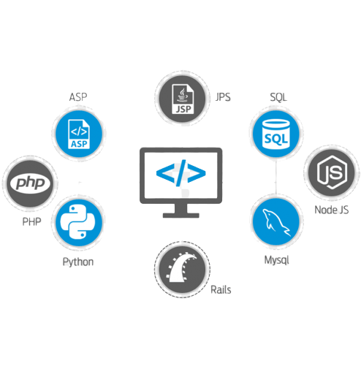
Technologies & Tools

Slide 21
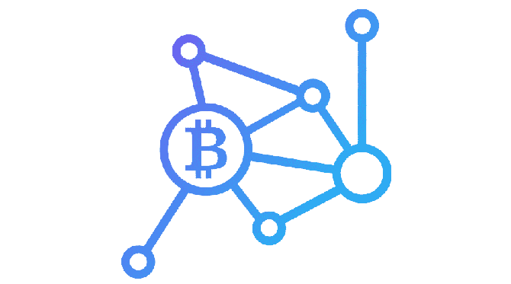
What is Block Chain?
Block Chain is a digital ledger of transactions that is duplicated and distributed across the entire network, and stores data in a way that makes it difficult or impossible to change, or hack.
How it builds!

Slide 22

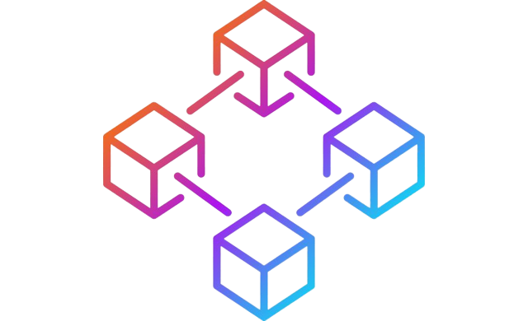

Ethereum
Block Chain Framework
Solidity!

Slide 23



Truffle Suits
Truffle
Ganache
MetaMask

Slide 24

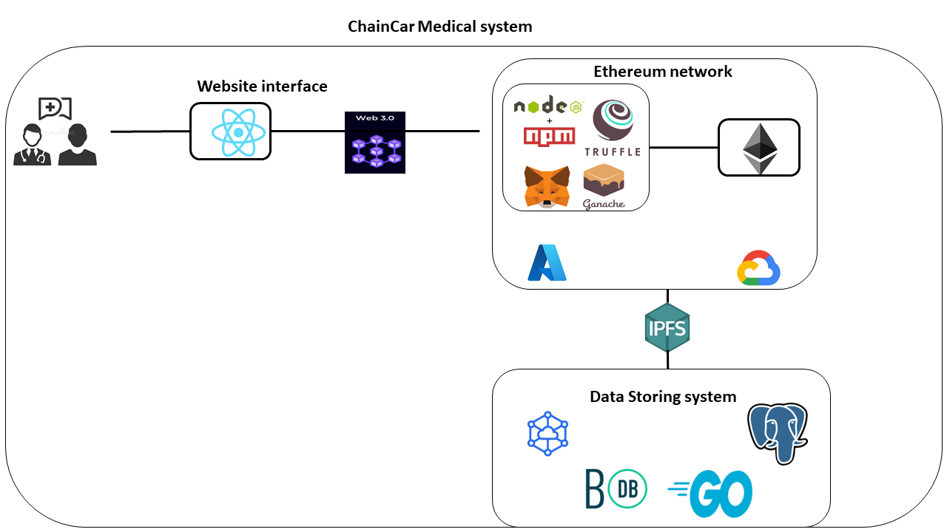
Technologies

Slide 25
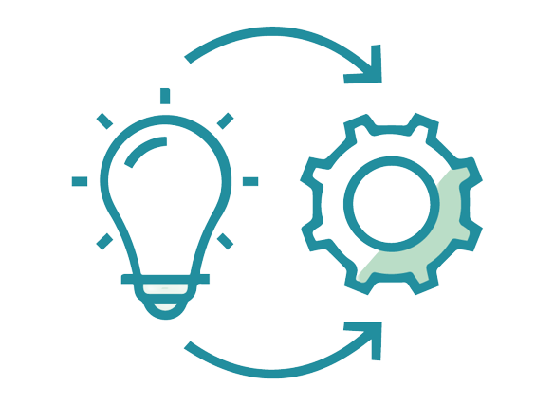
Implementation

Slide 26

System Arch
Struct
Transactions
Mapping
Address

Slide 27

Smart Contracts
What are Smart Contracts?

Slide 28

Reports
Boolean bitmap algorithm
Component.SaaS

Slide 29

Prediction
Binary Code algorithm

Slide 30

ChainCare Demo

Slide 31

Marketing Analysis

Slide 32

What Makes ChainCare Unique?
Using Block Chain rather than the traditional Databases makes the ChainCare application more:
Secure
Privacy
High Availability

Slide 33

What Makes ChainCare Unique?
Availability of information and long-time storing allows to a future processing like Genetic Function and more accuracy for Predicted Function.

Slide 34

SWOT Analysis
s
W
Weaknesses:
-Diseases prediction functions only 60% accurate
Strengths:
-information is totally secured
-permissioned activities
-helps doctors with accurate diagnoses
-reduce costs and much effort
-provides an indications through analytical reports
Internal
O
T
Opportunities:
-Having high growth rate of information amounts to be used in future
-Over time highly growth rate of data will improve the accuracy of prediction function
Threats:
-people can't’ deal with electronic systems
-leak of required resources with user physical (electronic device) or software(WIFI/internet)
External

Slide 35

Future Works

Slide 36

Future Works
Smart Cards
Connecting with other systems
Create Genetic function and read genes (DNA,RNA)
Improving the accuracy of prediction function

Slide 37
Thank You!
Any Questions?
Special thanks from ChainCare team to our supervisor Prof.Laila Abdelhamid for her efforts

